Slide 1
S/4 HANA Finance New Asset Accounting
Kalyan Yellamilli
Senior Consultant
22-03-2019

Slide 2
Challenges in Classic Asset Accounting
Key Changes in Asset Accounting
Architectural & Functionality Impact
Changes in Transaction Codes
Configuration, and Closing Process Impact

Slide 3
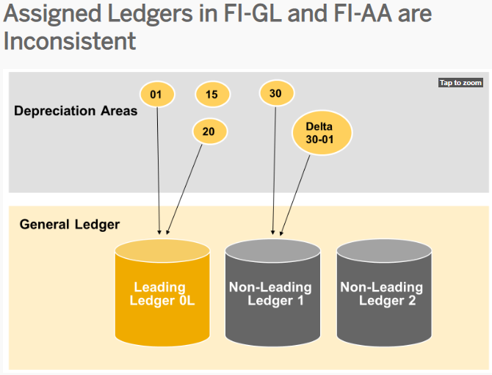
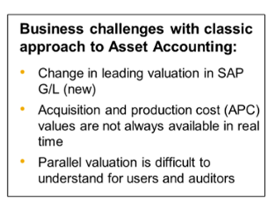
1. Challenges in Classic Asset Accounting

Slide 4
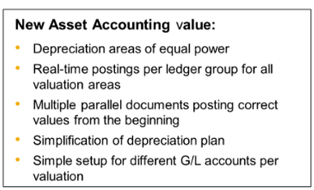
2. Key Changes in Asset Accounting
Elimination of Reconciliation between Asset Accounting and General Ledger
Classic FI-AA is no longer available
Both Ledger approach and Accounts approach’s are available
New Depreciation calculation engine is mandatory with the activation of business function EA-FIN

Slide 5
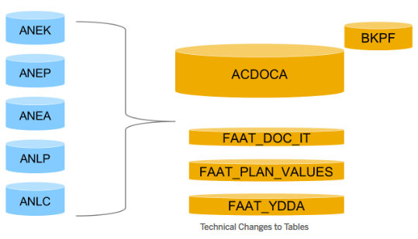
3. Architectural Impact
All FI-AA Line item Postings are stored in ACDOCA Table, and Header information is stored in BKPF
All Statistical Asset line item information is stored in Table FAAT_DOC_IT
Plan Data is stored in Table FAAT_PLAN_VALUES instead of ANLP and ANLC Tables. Planned depreciation values are calculated on Real time basis. During Month Depreciation run, Actual postings will use planned depreciation values.
Year end Depreciation attributes are stored in FAAT_YDDA
FI-AA Tables ANEK, ANEP, ANEA, ANLP and ANLC will not be updated going forward
Assets with issues/errors won’t stop the full depreciation run
New Asset Accounting Architecture

Slide 6
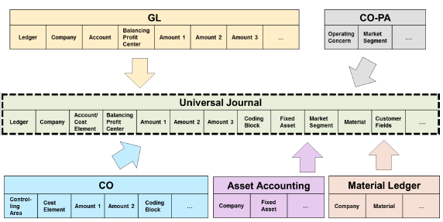
3. Functionality Impact – Universal Journal
The universal journal integration provides the following benefits:
No redundancy in data storage
Reconciliation between G/L and AA is ensured by design
No reconciliation step in financial close required
All non-statistical items are updated as universal journal entries
Reporting for previous fiscal years is possible due to compatibility views even after migration
Transparent assignment of depreciation area to accounting principle
Depreciation posted with all details: accumulated depreciation and depreciation cost by asset

Slide 7
3. Functionality Impact
Reporting is based on line items and the Virtualization of totals has been removed
Reconciliation is not required GL or within FI-AA Itself. General Ledger Accounting and Asset Accounting are reconciled due to Universal Journal Entry.
The asset depreciation runs less time because the depreciation values are computed and posted in real time and it is no longer part of the depreciation run itself
Periodic posting runs are no longer valid due to real time update
If a period is skipped, depreciation run can be re-executed for an asset for the skipped period

Slide 8
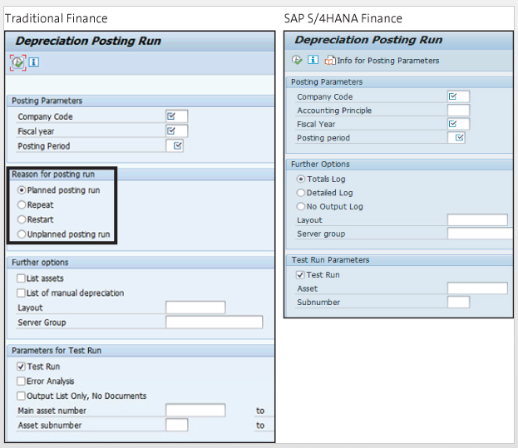
Depreciation run
Depreciation run selection has been simplified with a new screen.
You can now run depreciation posting for accounting principle that can be entered on the selection screen.
The reason for posting run section, which includes planned posting run, repeat, restart, and unplanned posting run radio buttons have been eliminated.
The depreciation posting run detailed log option reports at the individual asset level with corresponding cost center information. Totals and Detailed Logs are available.

Slide 9
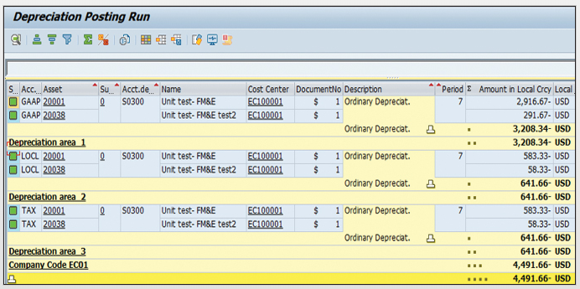
Depreciation Run Log

Slide 10
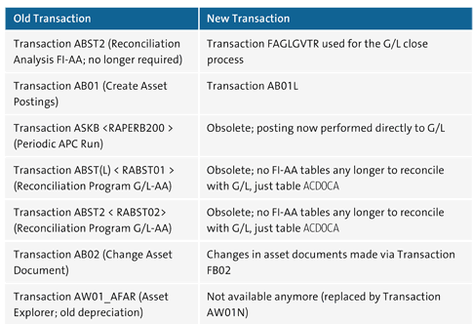
4. Changes in Transaction Codes & Tables
The following transactions have been replaced or become obsolete in new asset accounting

Slide 11
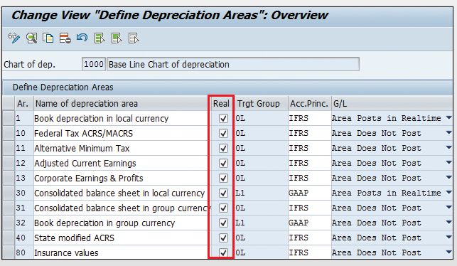
5. Configuration Impact:- Define how Depreciation Areas post to the General Ledger

Slide 12
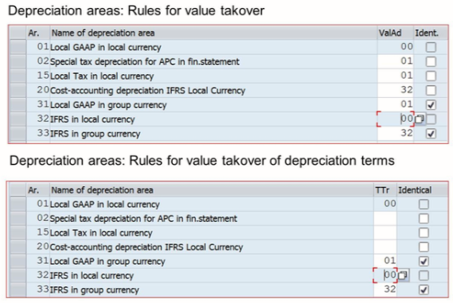
Adapt value takeover and parameter take over

Slide 13
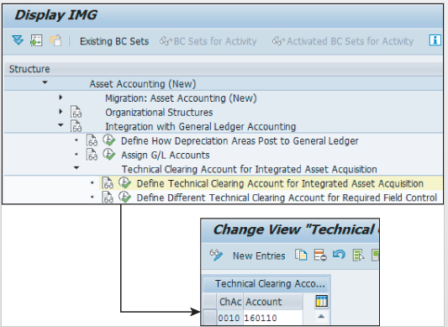
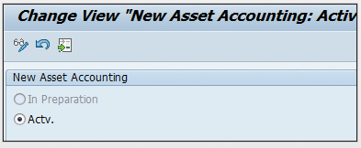
Technical Clearing Account for Integrated Asset Acquisition
Technical clearing account for integrated asset acquisitions is posted automatically and always has a zero balance for each accounting principle in char of depreciation
Activate new Asset Accounting
You Activate new functions for new asset accounting. The system performs various checks before saving the setting. Once it is activated, you can start posting using the new logic

Slide 14
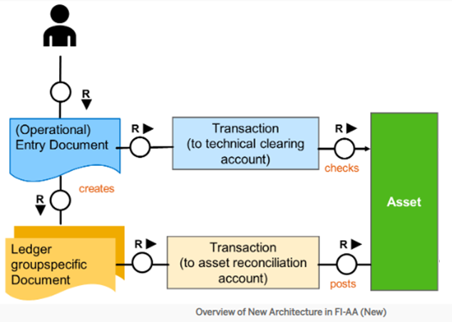
Integrated Asset Acquisition:-

Slide 15
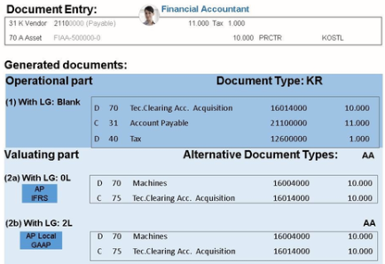
Posting Logic:- For an integrated asset acquisition posting, the system divides the business transaction into an operational part and a valuating part:

Slide 16
Asset Migration
AS91 used to be single transaction to load asset master data and previous and current year values.
In S/4 HANA, it is three step process
1) Master Data is loaded through transaction AS91
2) Asset Historical Values, accumulated depreciation, and depreciation for previous years are loaded through Transaction ABLDT
3) The current year acquisitions are managed through transaction AB01
Asset migration through AS91 does not upload values in S/4 HANA Finance.

Slide 17
Closing Process Impact
Real time integration of asset with GL occurs, eliminating reconciliation steps.
The APC posting run is not required in S/4 HANA Finance
The planned depreciation value of the asset is reflected in real time and it is updated with every master data change and every transaction posting.
No separate program is executed for balance carry forward in FI-AA. The general carry forward transaction of FI Transfers AA balance by default.
Planned depreciation is automatically calculated for the new year after the balance carry forward (year end close) is performed.
The depreciation run is executed faster due to simple processing logic, new data structure and parallel processing.

Slide 18
Any Questions ?

Slide 19
Thank You
Kalyan Yellamilli
Senior Consultant
22/03/2019

